Slide 1
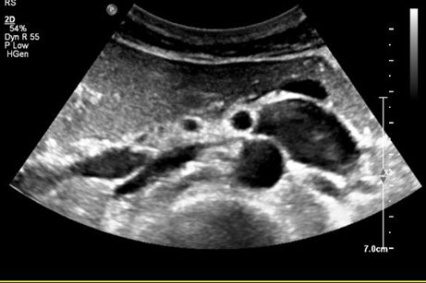
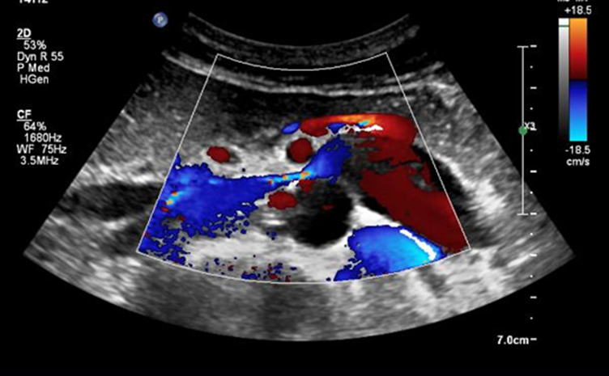
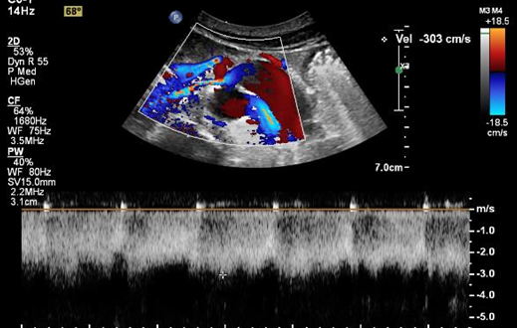
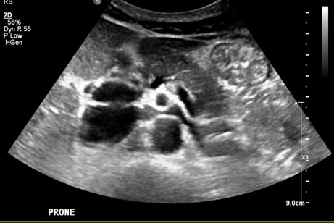
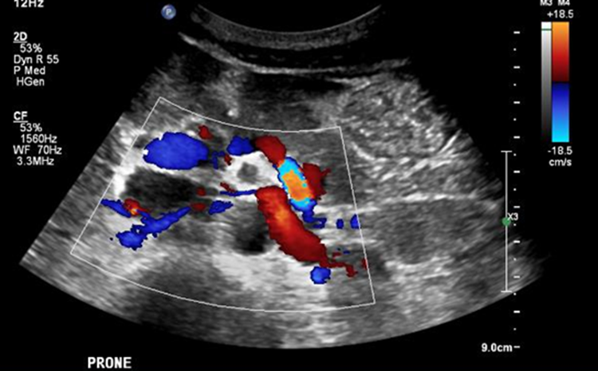
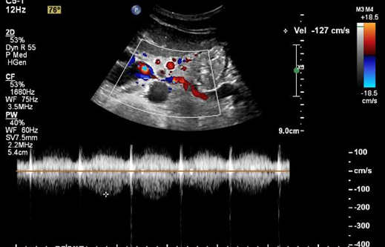
45/M, Proteinuria caused by nutcracker syndrome
A
B
C
A
B
C
D
E
F
A-C. Doppler ultrasound images of left renal vein (LRV) in supine position. A, Grey scale ultrasound image shows markedly dilated LRV caused by its compression between aorta and superior mesenteric artery. B, Color Doppler ultrasound shows bright flow signals (arrows) in the narrowed aoromesenteric portion of LRV. C, Peak flow velocity at the narrowed LRV was 303cm/sec.
D-F. Doppler ultrasound images of LRV in right lateral decubitus position show markedly relieved compression. Peak flow velocity at aortomesenteric portion of LRV is 127cm/sec.

Slide 2
The best modality to measure flow velocity of LRV for diagnosis of nutcracker syndrome is Doppler ultrasound
Doppler velocity information according to the position is helpful to the patients
Radiology 1996;198:93-97
https://doi.org/10.3348/kjr.2019.0084
Seung Hyup KIM
K-Radiology Clinic

